Slide 1
Fully integrated model of the HES-OFF hybrid system

Slide 2
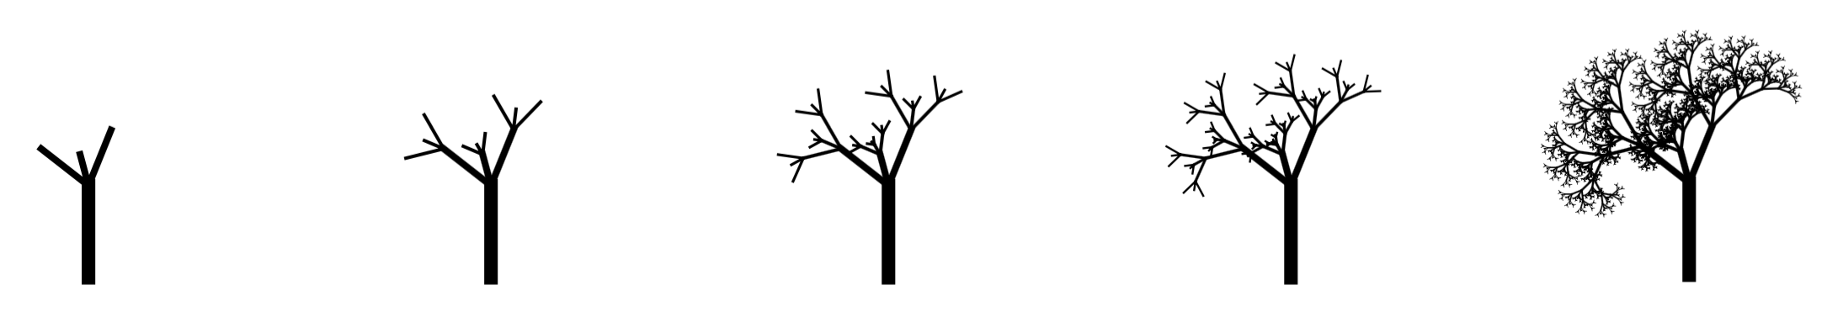
Integrated Analysis
Scenario Generation
System Constraints
Analysis & Optimization
Gas Turbine: type, #, MinSP
Wind Turbine: type, #, MaxCurtail
Storage: electrolyzer and fuel cell sizes
Physical: footprint, weight
Power: electrical, thermal
Operational: peak vs. tail, availability
Emissions: CO₂, NO_{x}, CO
Storage: capacity
Operational: H₂ to GT, curtailed load

Slide 3
Models integration
The process model (matlab) was succesfully integrated with the offshore grid model (simulink)
The integrated model allows to screen designs in terms of both
Process performance
Grid stability
The next step is the design optimization of the HES-OFF concept guided by the dynamic performance of the grid

Slide 4

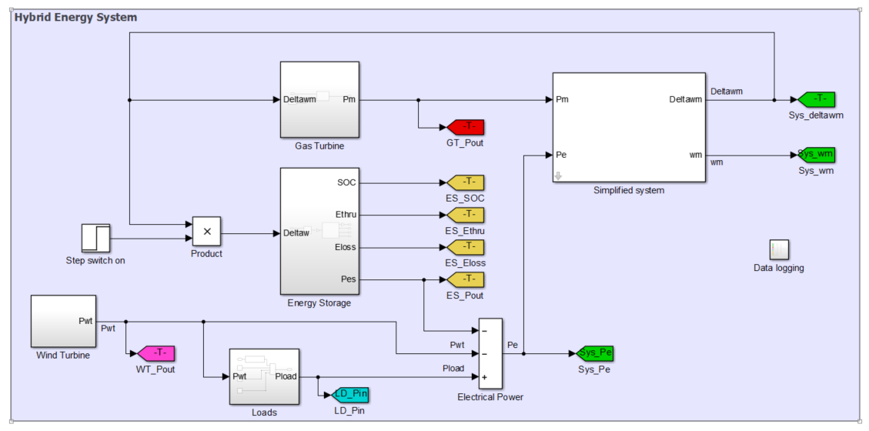
Models integration
Run long-term design model
Process the results
Proposed design
Design outputs
Energy storage
Inputs to modify the design
Feasible HES-OFF design
NO
Dynamic constraints satisfied?
YES
Test grid stability with the given design
SIMULINK MODEL

Slide 5
Hybrid system – long-term design
Inputs to the design
Power demand during lifetime
Heat demand during lifetime
GT (LM2500 vs LM6000)
GT operation (max/min load)
Fraction of H₂ in GT
Wind speed data series for North Sea
Wind turbine (NREL vs Hywind)
Fuel cell and electrolyser stacks
H2 storage method
Outputs
Size of H₂ storage
Size of electrolyser stack
Size of fuel cell stack
CO₂ emissions
Weights and footprints
Costs

Slide 6
Hybrid system – long-term design
Inputs to the design
Power demand during lifetime
43.6/ 35.2/32.9 MW
Heat demand during lifetime
15 MW
GT (LM2500 vs LM6000)
Both
GT operation (max/min load)
95%/40%
Fraction of H₂ in GT
20% vol.
Wind speed data series for North Sea
Sleipner data from the Norwegian Meteorological Institute
Wind turbine (NREL vs Hywind)
Hywind
Fuel cell and electrolyser stacks
Modelled (see Marcin’s presentation)
H2 storage method
Gaseous H2 subsea (see Prototech’s presentation)
Outputs
Size of H₂ storage
Size of electrolyser stack
Size of fuel cell stack
CO₂ emissions
Weights and footprints
Costs

Slide 7
Storage strategy
Deficit of power (peak years)
Evaluate total H2 needed to be used as fuel in the fuel cells
Whenever possible increase GT load and use extra power to produce H2 in electrolyser
Stop when reaching a maximum storage level
Stop when reaching overall H2 needed
Surplus of power (tail years)
Evaluate H2 produced due to surplus power
Whenever possible use fuel cells instead of GT
When the level of storage reaches a maximum, max H2 used in GT
If not all H2 used, some H2 sent continously to GT during year

Slide 8
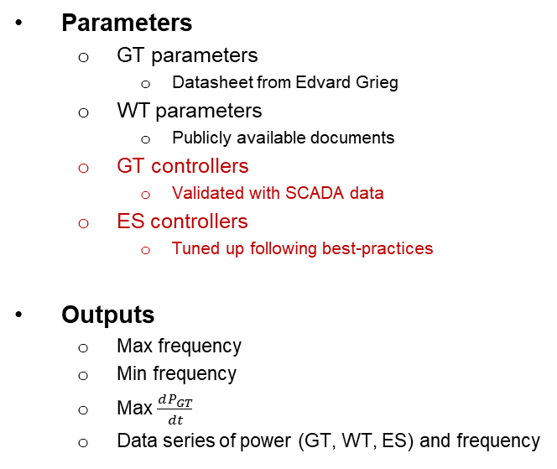
Hybrid system – short-term analysis
Inputs to the analysis
GT (LM2500 vs LM6000)
GT operation (max/min load)
Wind turbine (NREL vs Hywind)
Fuel cell and electrolyser sizes
Wind speed variation
MET Norway data
Kaimal spectrum
Power demand variation
SCADA data Edvard Grieg
Max load variation = 5.3 MW
Parameters
GT parameters
Datasheet from Edvard Grieg
WT parameters
Publicly available documents
GT controllers
Validated with SCADA data
ES controllers
Tuned up following best-practices
Outputs
Max frequency
Min frequency
Max $\frac{dP_{GT}}{dt}$
Data series of power (GT, WT, ES) and frequency
Long-term design
Assumptions
Statistical analysis

Slide 9
Some results
INPUTS |  | Only GT | GT + WIND |  |  | GT + WIND + EN STORAGE
GT |  | LM2500 | LM2500 | LM2500 | LM2500 | LM2500 | LM2500 | LM2500
GT load limits |  | Variable | Variable | Variable | Variable | Variable | Variable | Variable
max GT load | % | 90 % | 90 % | 90 % | 90 % | 95 % | 95 % | 95 %
min GT load | % | 40 % | 40 % | 40 % | 40 % | 40 % | 40 % | 40 %
Wind power capacity | MW | - | 12 | 18 | 24 | 12 | 18 | 24
max H2 in GT |  | - | - | - | - | 0.037 | 0.037 | 0.037
OUTPUTS
Size of the H2 storage | kg | - | - | - | - | 123883 | 55388 | 70220
Size of the electrolyser stack | MW | - | - | - | - | 4 | 4 | 6
Size of the fuel cell stack | MW | - | - | - | - | 4 | 4 | 4
CO2 emissions | Mt | 3.51 | 2.71 | 2.42 | 2.25 | 2.48 | 2.25 | 2.07
compared to only GT |  | - |  |  |  | -29.2 % | -35.7 % | -40.9 %
compared to GT+wind |  | - |  |  |  | -8.2 % | -6.9 % | -8.0 %
Small GT case:
Good emissions reduction potential
Two GTs with HES-OFF concept
Unfeasible size H2 storage

Slide 10
Some results
INPUTS |  | Only GT | GT + WIND |  |  | GT + WIND + EN STORAGE
GT |  | LM2500 | LM2500 | LM2500 | LM2500 | LM2500 | LM2500 | LM2500
GT load limits |  | Variable | Variable | Variable | Variable | Variable | Variable | Variable
max GT load | % | 90 % | 90 % | 90 % | 90 % | 95 % | 95 % | 95 %
min GT load | % | 40 % | 40 % | 40 % | 40 % | 40 % | 40 % | 40 %
Wind power capacity | MW | - | 12 | 18 | 24 | 12 | 18 | 24
Size of the electrolyser | MW | - | - | - | - | 4 | 4 | 6.1
Size of the fuel cell | MW | - | - | - | - | 3.6 | 3.6 | 3.6
OUTPUTS
Max frequency | Hz | 60.00 | 60.18 | 60.26 | 60.35 | 60.14 | 60.22 | 60.29
Min frequency | Hz | 59.22 | 58.96 | 58.85 | 58.69 | 59.05 | 58.96 | 58.85
GT max dP/dt | % / s | 1.52 | 3.72 | 4.42 | 5.05 | 3.08 | 4.03 | 4.43
Pass NORSOK E-001? | Yes / No | Yes | Yes | Yes | No | Yes | Yes | Yes
compared to rated values | f_{max} | +0.0 % | +0.3 % | +0.4 % | +0.6 % | +0.2 % | +0.3 % | +0.5
 | f_{min} | -1.3 % | -1,7% | -1.9 % | -2.2 % | -1.6 % | -1.7 % | -1.9%
Small GT case:
Up to 3 WTs without Storage
Fuel cell allows one additional WT
Reduced range of operation requires 3 GTs to cover spinning reserve and n-1 criteria
When wind power is high, one GT can be left in cold-standby

Slide 11
Some results
INPUTS |  | Only GT | GT + WIND |  |  | GT + WIND + EN STORAGE
GT |  | LM6000 | LM6000 | LM6000 | LM6000 | LM6000 | LM6000 | LM6000
GT load limits |  | Variable | Variable | Variable | Variable | Variable | Variable | Variable
max GT load | % | 90 % | 90 % | 90 % | 90 % | 95 % | 95 % | 95 %
min GT load | % | 40 % | 40 % | 40 % | 40 % | 40 % | 40 % | 40 %
Wind power capacity | MW | - | 12 | 18 | 24 | 12 | 18 | 24
max H2 in GT |  | - | - | - | - | 0.037 | 0.037 | 0.037
OUTPUTS
Size of the H2 storage | kg | - | - | - | - | 7904 | 5876 | 24871
Size of the electrolyser stack | MW | - | - | - | - | 4 | 4 | 9
Size of the fuel cell stack | MW | - | - | - | - | 1 | 1 | 1
CO2 emissions | Mt | 2.92 | 2.48 | 2.36 | 2.30 | 2.45 | 2.31 | 2.21
compared to only GT |  | - |  |  |  | -16.3 % | -20.8 % | -24.4 %
compared to GT+wind |  | - |  |  |  | -1.5 % | -2.0 % | -4.0 %
Big GT case:
More limited emissions reduction
Single GT with HES-OFF concept
Feasible size H2 storage

Slide 12
Some results
INPUTS |  | Only GT | GT + WIND |  |  | GT + WIND + EN STORAGE
GT |  | LM6000 | LM6000 | LM6000 | LM6000 | LM6000 | LM6000 | LM6000
GT load limits |  | Variable | Variable | Variable | Variable | Variable | Variable | Variable
max GT load | % | 90 % | 90 % | 90 % | 90 % | 95 % | 95 % | 95 %
min GT load | % | 40 % | 40 % | 40 % | 40 % | 40 % | 40 % | 40 %
Wind power capacity | MW | - | 12 | 18 | 24 | 12 | 18 | 24
Size of the electrolyser | MW | - | - | - | - | 4 | 4 | 6.6
Size of the fuel cell | MW | - | - | - | - | 1.1 | 1.1 | 1.6
OUTPUTS
Max frequency | Hz | 60.00 | 60.18 | 60.27 | 60.35 | 60.14 | 60.22 | 60.30
Min frequency | Hz | 59.13 | 59.01 | 58.85 | 58.68 | 59.06 | 58.92 | 58.80
GT max dP/dt | % / s | 2.34 | 2.62 | 3.05 | 3.49 | 2.49 | 2.88 | 3.21
Pass NORSOK E-001? | Yes / No | Yes | Yes | Yes | No | Yes | Yes | Yes
compared to rated values | f_{max} | +0.0 % | +0.3 % | +0.4 % | +0.6 % | +0.2 % | +0.4 % | +0.5
 | f_{min} | -1.4 % | -1,7% | -1.9 % | -2.2 % | -1.6 % | -1.8 % | -2.0%
Big GT case:
Up to 3 WTs without Storage
A larger fuel cell allows one additional WT
Increased range of operation requires 2 GTs to cover spinning reserve and n-1 criteria
When wind power is high, one GT can be left in cold-standby

Slide 13
Fuel cell and electrolyser performance
In the first simulations, constant values of fuel cell and electroyser efficiency were used
Performance electrolyser: 0.007 kg/MJ
Performance fuel cell: 66 MJ/kg
Models for the fuel cell and for the electrolyser were developed and integrated to the main model for the HES-OFF design
The models return the performance of the fuel cell and of the electrolyser at the specific conditions tested
The stacks are not always run at optimal conditions, thus lower performances are obtained. What is the influence on the design?

Slide 14
Fuel cell and electrolyser performance
INPUTS |  | Only GT | GT + WIND |  |  | GT + WIND + EN STORAGE |  |  | GT + WIND + EN STORAGE
GT |  | LM6000 | LM6000 | LM6000 | LM6000 | LM6000 | LM6000 | LM6000 | LM6000 | LM6000 | LM6000
GT load limits |  | Variable | Variable | Variable | Variable | Variable | Variable | Variable | Variable | Variable | Variable
max GT load | % | 90 % | 90 % | 90 % | 90 % | 95 % | 95 % | 95 % | 95 % | 95 % | 95 %
min GT load | % | 40 % | 40 % | 40 % | 40 % | 40 % | 40 % | 40 % | 40 % | 40 % | 40 %
Wind power capacity | MW | - | 12 | 18 | 24 | 12 | 18 | 24 | 12 | 18 | 24
max H2 in GT |  | - | - | - | - | 0.020 | 0.020 | 0.020 | 0.037 | 0.037 | 0.037
FC and EL efficiency |  |  |  |  |  | fixed | fixed | fixed | model | model | model
OUTPUTS |  |  |  |  |  |  |  |  | 26.6 % | 36.4 % | -52.5 %
Size of the H2 storage | kg | - |  |  |  | 7904 | 5876 | 24871 | 10010 | 8014 | 11824
Size of the electrolyser stack | MW | - |  |  |  | 4 | 4 | 9 | 4 | 4 | 7
Size of the fuel cell stack | MW | - |  |  |  | 1 | 1 | 1 | 1 | 1 | 1
CO2 emissions | Mt | 2.92 | 2.48 | 2.36 | 2.30 | 2.45 | 2.31 | 2.21 | 2.45 | 2.32 | 2.23
 |  |  |  |  |  |  |  |  | 0.0 % | 0.2 % | 0.9 %
Need to find a compromise between emission reduction and storage size

Slide 15
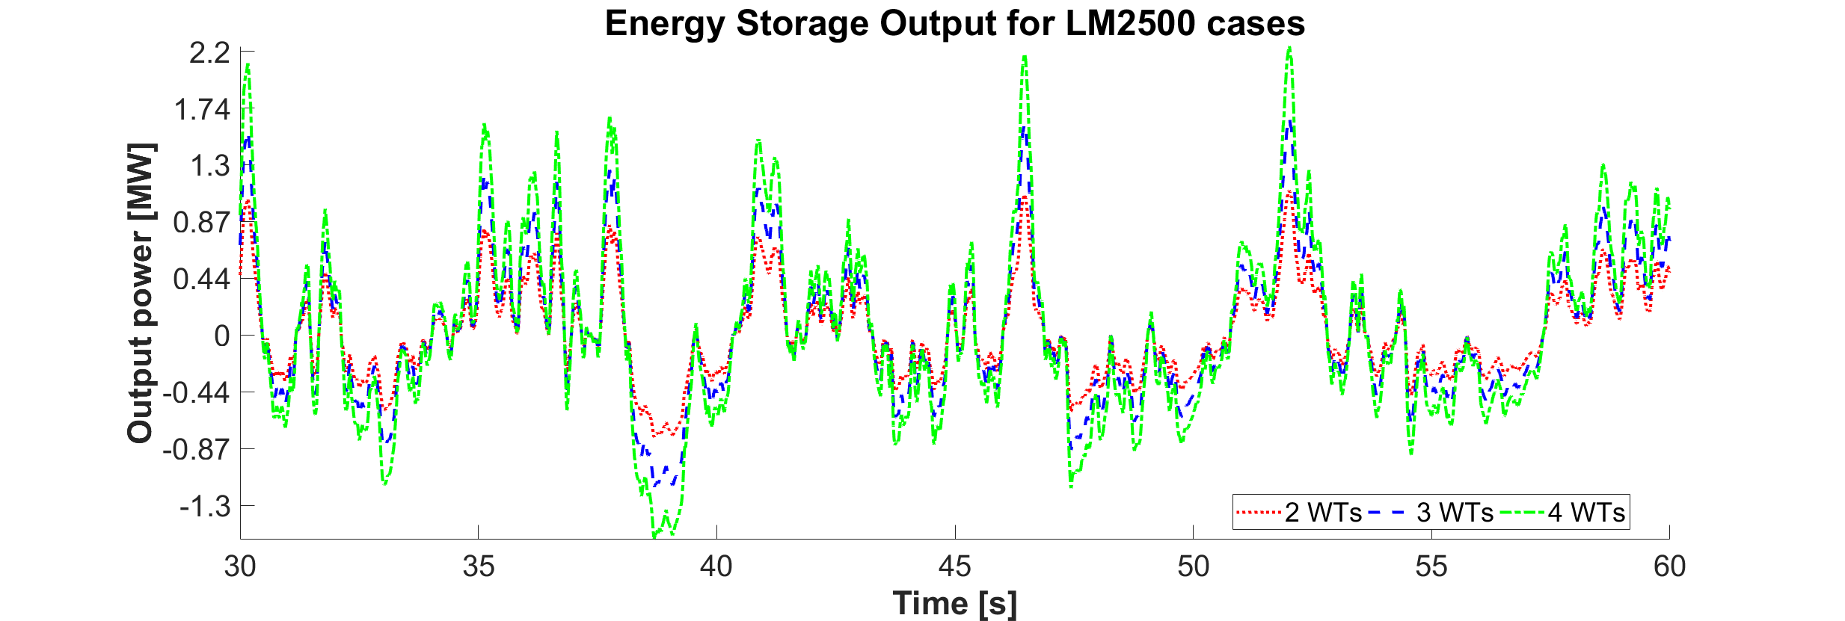
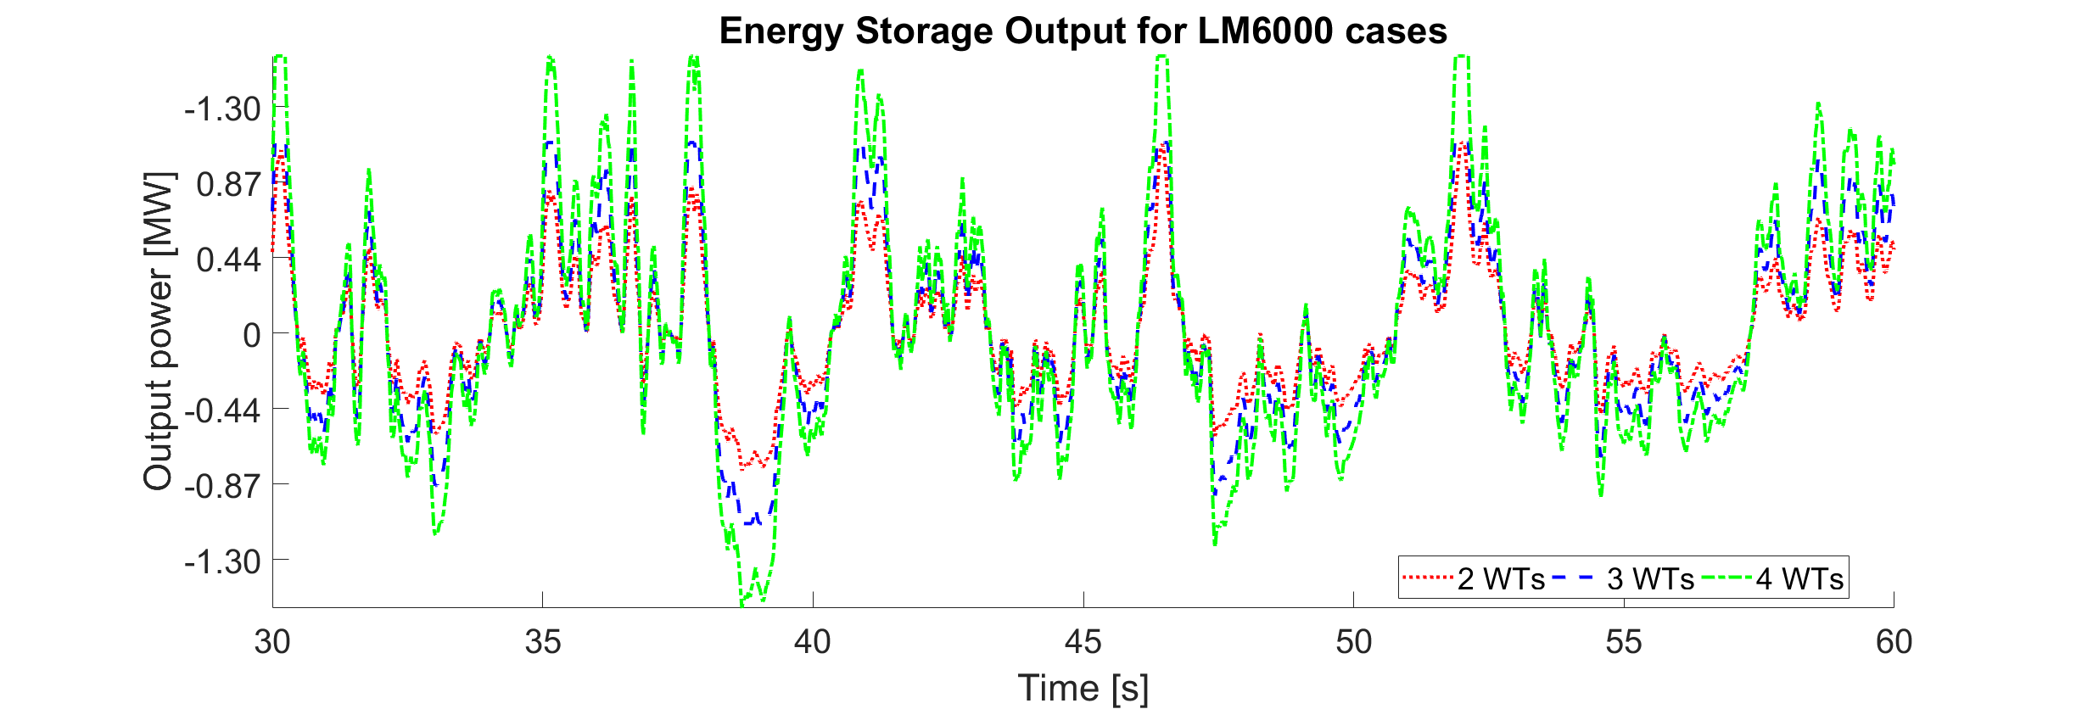
Fuel cell and electrolyser performance
Electrical grid model is not considering restrictions in the operation of fuel cells and electrolysers
However, wind power production might change very fast in low wind speeds
This requires the energy storage system to quickly inject or absorb power to keep a stable grid frequency
A realistic solution must consider an alternative short-term storage
Supercapacitors
Variable pressure of reservoir
Inertia of motors

Slide 16
Way forward
Refine the integrated model
Develop optimization procedure
Introduce weight and footprint considerations
Constraint the H2 storage size by allowing to waste some wind power
Testing HES-OFF as a short-term energy storage concept (smoothing wind power contribution rather than substituting a GT)
Further develop fuel cell and electrolyser model (Fredrik’s master’s thesis)
Investigate wind data influence on design (Åsmund’s project + additional analyses)

Slide 17
Way forward
Wind data influence: an example
LM2500
Wind farm 18 MW
Sleipner wind data set
H2 storage size
55388 kg_{H2}

Slide 18
Way forward
Wind data influence: an example
LM2500
Wind farm 18 MW
Sleipner wind data set
H2 storage size
55388 kg_{H2}
Wind data set used is characterized by an uneven distribution of high wind speed instances and low wind speed instances during the year
Several consecutive hours with low wind
HES-OFF design challenge

